Slide 1
Creating User Defined Targets on the ScanStation P-16/30/40
A Quick Guide

Slide 2
Background
The Leica ScanStation P16/P30/P40 has a new type of laser with a different wavelength than all previous generation ScanStations
A new 4.5” black and white Tilt-N-Turn target (GZT21) was also introduced and is intended to be the primary-use target
Users of the new scanners will note that 3” planar targets no longer appear in the ScanStation’s default target list
3” planar targets are used to create Leica Twin-Target Poles
The TTP for the ScanStation C10 uses blue and white 3” targets
The TTP for the ScanStation P20 uses gray and white 3” targets
These instructions show you how to create user defined targets so that you can use your gray and white TTP’s with P30/40

Slide 3
Background
A ScanStation P30/40 can actually scan a 3” gray and white target just fine provided the user doesn’t point the target directly at the scanner
A small rotation of 10 to 15 degrees will permit it to acquire
Prior to doing so (and after every time you reflash the firmware on your ScanStation) you will need to manually enter the following target definitions

Slide 4
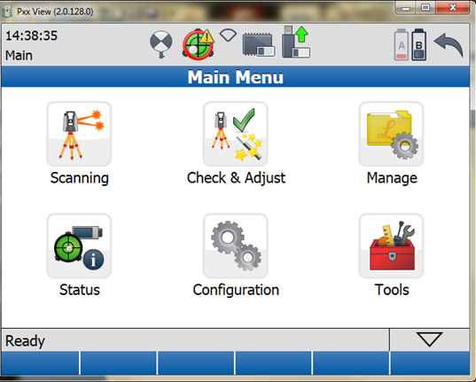
Step 1 - From the Main Menu Select “Manage”

Slide 5
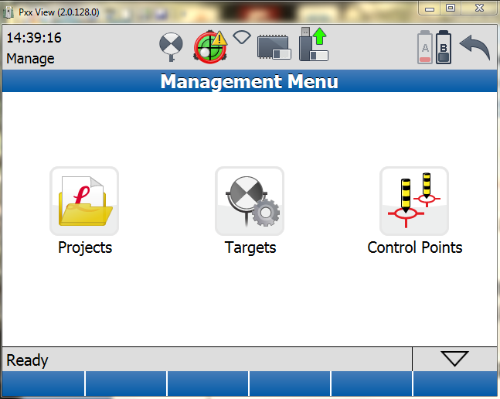
Step 2 - Then select “Targets”

Slide 6
Step 3 - Select “New”

Slide 7
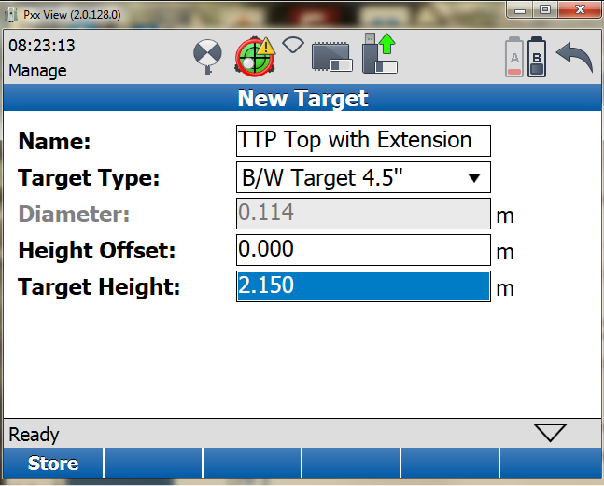
Step 4 -Type in the Target’s Name and Height
Select this type even though you will be scanning a 3” gray and white P20 target
Press “Store” to complete entry

Slide 8
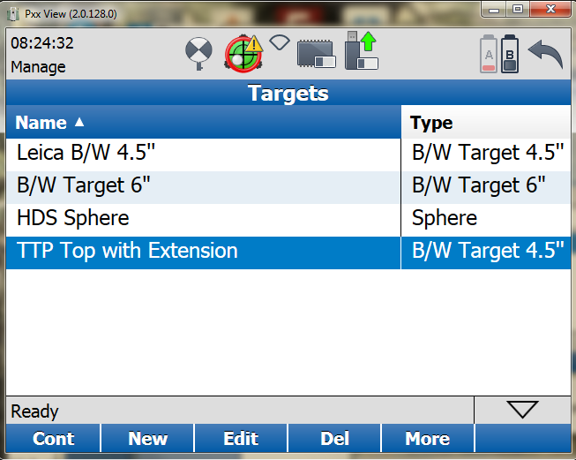
The target now appears in your target list

Slide 9
Repeat the process for all desired user defined targets
TTP Top with Extension. Height is 2.15m - DONE
TTP Bottom with Extension. Height is 0.45m – TO BE ENTERED
TTP Top w/o Extension. Height is 1.90m – TO BE ENTERED
TTP Bottom w/o Extension. Height is 0.2m – TO BE ENTERED

Slide 10
Final thought
The newer P16/P30/P40 series scanner cannot be used to acquire older blue and white C10 targets of any kind.
When a C10 and a P16/P30/P40 are used on the same scene, some thought will need to be given as to how to register scan data from the two different instruments
C10 ScanWorld
P16/30/40 ScanWorld

